Slide 1
General Info
Repository = A “folder” which contains data
Commit = Saving the current state of your data
Branch = A “story-line” of your saved stated (commits)
Push = Upload the current state of your data to a remote repository
Pull = Download the current state of the data which can be found on the Remote (online) repository
Merge = Combine two “current states” of your data
Merge Conflict = Happens when same data was modified after the latest “common commit”

Slide 2
Initial Setup
1. Download & Install Git (default settings) https://git-scm.com/downloads
2. Choose a git versioning system (Github, Gitlab, Bitbucket, SVN … )
3. Create an account (free) https://github.com/

Slide 3
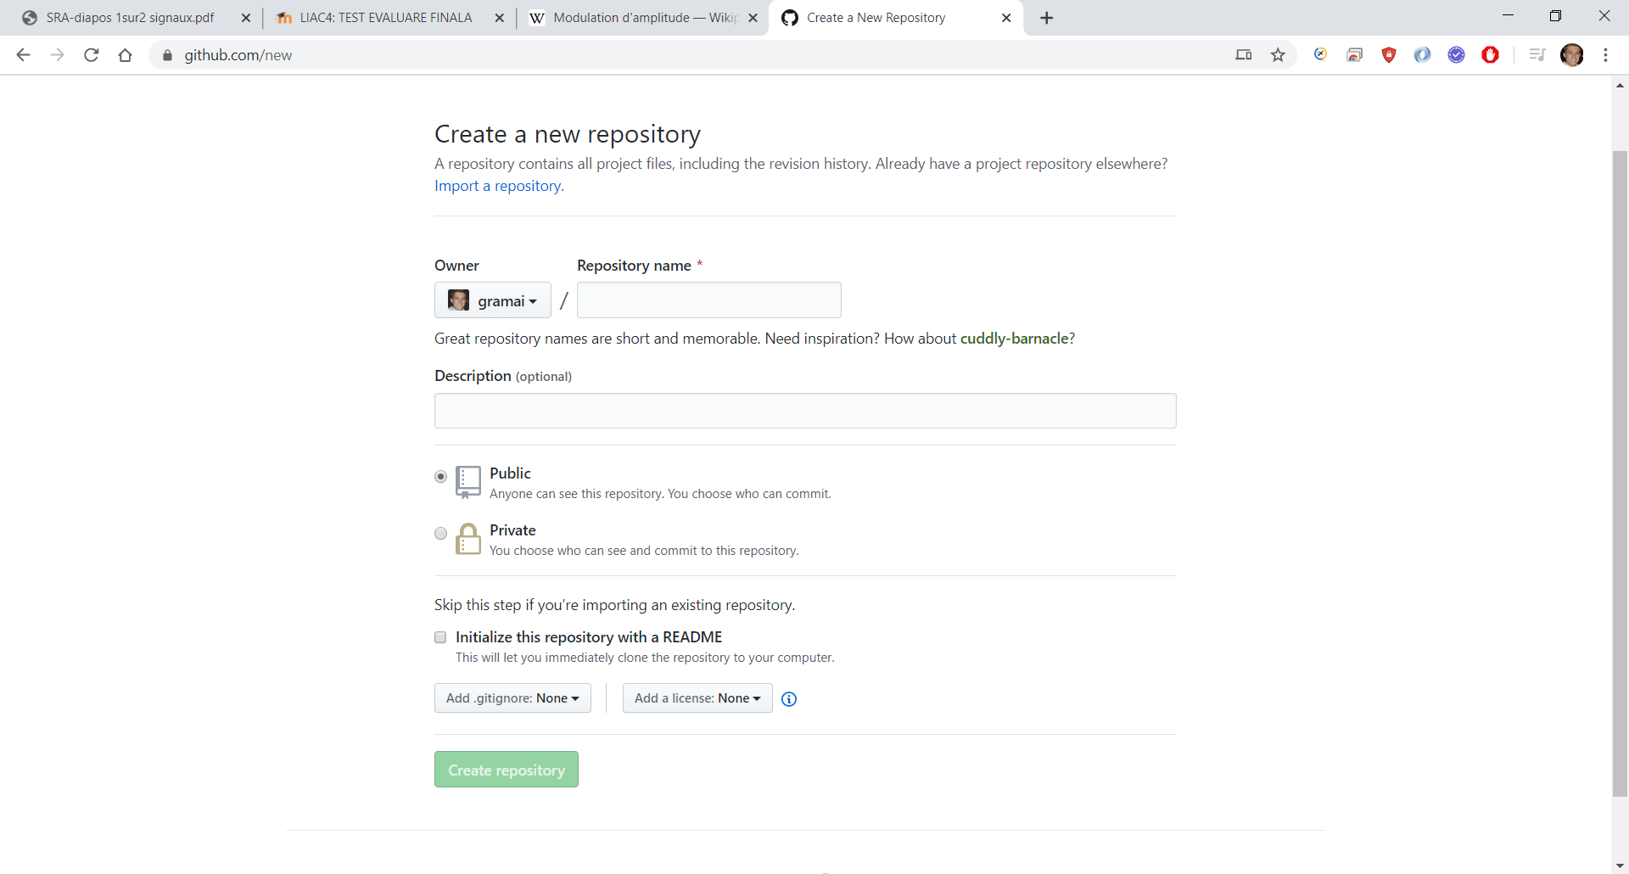
Project Setup
1. Create a Remote Project Repository
https://github.com/new
e.g. “portfolio”
Public

Slide 4
Project Setup
2. Create a local git repository and link it to the remote repository
2.1 Go to the desired folder
2.2 Open a git console (Right Click → “Git bash here”)
2.3 Write “git init” into the console
2.4 Write “git remote add origin <your_repo_link>.git”
2.5 Write “git add .” to include everything in the folder
2.6 Write “git push -u origin master” to upload everything that was added at 2.5

Slide 5
Project Updates
1. Local updates
1.1 Modify something (add another file, subfolder or modify existing ones)
1.2 Add your changes to the next commit “git add .” or “git add <specific_file_to_add>”
1.3 Commit your changes ‘git commit -m “<your_commit_message>” ’
1.4 Push your changes to the remote repository “git push origin”

Slide 6
Project Updates
2. Local updates using separate Branches
2.1 Create a new branch ‘git checkout -b “<your_new_branch_name>” ’
2.2 Modify something (add another file, subfolder or modify existing ones)
2.3 Add your changes to the next commit “git add .” or “git add <specific_file_to_add>”
2.4 Commit your changes
2.4.1 First commit to new branch:
‘git commit –set-upstream origin <your_new_branch_name>’
2.4.2 Following commits:
‘git commit -m “<your_commit_message>” ’
2.5 Push your changes to the remote repository “git push origin”

Slide 7
Project Updates
3. Merging your new branch
3.1 Checkout to the target branch ‘git checkout “<your_target_branch>” ’
3.2 Pull from the source branch ‘git pull origin “<your_source_branch>” ’
3.3 Solve eventual merge conflicts (see next slides)
3.4 Push using “git push origin” to upload the merged branch “current state”

Slide 8
Project Updates
4. Merge conflicts
4.1 Via console (difficult, not recommended): https://help.github.com/en/github/collaborating- with-issues-and-pull-requests/resolving-a-merge-conflict-using-the-command-line
4.2 Via some kind of code management interface (use google for tutorials)
e.g. : Idea (java, kotlin) - https://www.youtube.com/watch?v=OM-Wv9_qRDY

Slide 9
Project Updates
5. Remote updates (via online User Interface)
5.1 Modify something (add another file, subfolder or modify existing ones)
5.2 Commit your changes
5.3 Go to your local repository
5.4 Pull from the remote repository with “ git pull origin <your_branc_name>”

Slide 10
Best Practices
1. Always keep one branch to the stable version (e.g. master or develop)
2. Always do modifications on new branches – you avoid overwriting important data. Rolling back is difficult and error-prone.
3. If you work in a team, have a clear branch management (conventions regarding branch naming, pull/push methods, merge request + peer-to-peer code review - https://www.youtube.com/watch?v=8fx-EaOUK2E )

